Slide 1



SKL at the Center
INSPERITY · KEEL AND NORTH STAR
Architecture for trustworthy AI and end-to-end compliance
Jeffrey Wallk · Sr. Semantic Architect · November 2026
Notes:
Opening: the SKL is the Keel from Navigating Rough Seas. This deck details the architecture, the data flows, and how design-time and run-time alignment keep every tool tied to one set of meanings.

Slide 2
Every tool creates its own meaning
THE PROBLEM
01
02
03
Same word, different meaning
Different words, same thing
Changes land in tools first
A term like “active employee” gets defined once per tool, and each definition drifts.
Insperity, customer and system labels point at one concept with no shared identifier.
Teams curate semantics inside each platform. Governance learns about it later, if at all.
Result: ambiguity, rework in every integration, and AI answers nobody can trace.
SKL at the Center · Architecture for trustworthy AI
2
Notes:
Heterogeneity is the default once several tools author vocabularies, taxonomies and rules. Visier, LangSmith, HRScale, Copilot and Compass each hold some meaning.

Slide 3
One source of truth.
Many consumers.
THE PRINCIPLE
Tools may extend the SKL inside the boundaries it sets. They may not redefine its concepts.
Notes:
The SKL is the single authoring point for terms, taxonomies, ontologies, rules, constraints, logic, calcs, persona models and mappings. Every other tool consumes it and may extend it only within its domain boundaries.

Slide 4
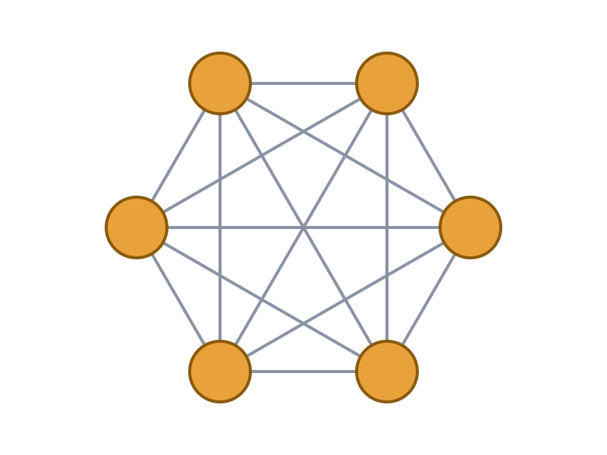
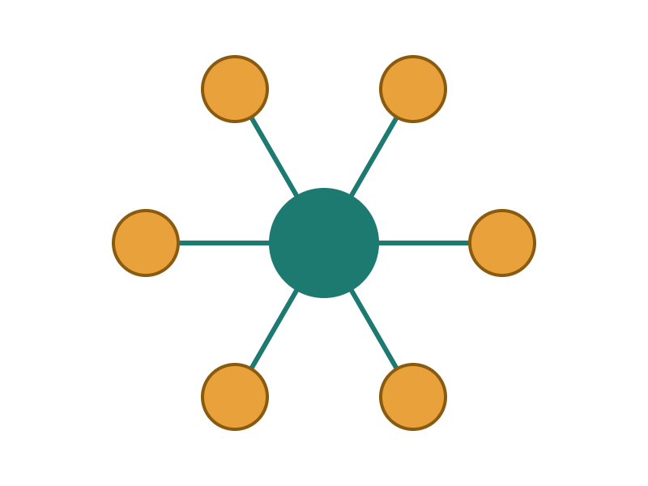
A hub removes the mapping sprawl
WHY A HUB
Point to point
Hub and spoke through the SKL
15 mappings to maintain
6 mappings to maintain
Six tools, every pair: n(n−1)/2
One per tool, each to the SKL: n
A seventh tool adds six mappings point to point, and one through the SKL.
SKL at the Center · Architecture for trustworthy AI
4
Notes:
Counting mappings is arithmetic, not a measurement: pairs grow as n(n−1)/2, hub connections grow as n. The bigger win is that every mapping lands on governed concepts instead of another tool’s private definition.

Slide 5

The SKL sits between sources and consumers
ARCHITECTURE
SOURCES
INBOUND
SKL CORE
OUTBOUND
CONSUMERS
Customer documents
Ingest and extract
Vocabularies, taxonomies, ontologies
Versioned releases
Visier
LangSmith
Content system
Candidate terms
Rules, constraints, logic, calcs
Publish APIs
Copilot and Compass
Data feeds
Map to core and domain
Personas and mappings
Labels per consumer
HRScale (Workday)
Employee handbooks
Steward review
Versioned graph, never exposed
Release ID on every payload
Partner APIs
Across every layer: Personas and Jobs access · provisioned UX with logging and audit · semantic governance standards
Return path: proposed extensions, drift reports and run-time telemetry flow back to steward review.
SKL at the Center · Architecture for trustworthy AI
5
Notes:
Read left to right: sources feed inbound services, stewards approve into the core, outbound services publish releases, consumers use them. Nothing reaches the graph directly.

Slide 6
One layer holds every artifact of meaning
INSIDE THE SKL
01
02
03
04
Vocabularies
Taxonomies
Ontologies
Rules and constraints
Controlled terms and their alternate labels.
Hierarchies and classifications.
Core and domain concepts and their relations.
Governed policy and compliance logic.
05
06
07
08
Logic and calcs
Persona models
Relations and mappings
Decision-model foundations
Deterministic calculations, versioned.
Who acts, in which job, with what access.
Links between concepts, and to consumer terms.
Governed inputs for downstream decision models.
The graph is reached only through internal semantic services. Staff change it only through provisioned UX with logging and audit.
SKL at the Center · Architecture for trustworthy AI
6
Notes:
Alternate labels (Insperity and customer) are built and maintained separately so core and domain vocabularies are not overloaded.

Slide 7
Five flows from source to consumer and back
DATA FLOWS
Sources
1 Ingest and extract
2 Map
3 Review
SKL release
Documents, content system, feeds, handbooks
Align to core and domain concepts, flag gaps
Stewards approve in provisioned UX, all logged
Versioned and diffed
INBOUND
Candidate terms and rules from each source
SKL release
4 Publish
Consumers align
5 Return
Back to 3
OUTBOUND AND RETURN
The only thing consumers see
APIs carry the release ID and per-consumer labels
Visier, LangSmith, agents and HRScale remap and refresh
Proposals, gaps, drift reports, telemetry
Stewards decide what enters the SKL
Graph never exposed
Every payload carries a release ID
Consumers write proposals, never source
SKL at the Center · Architecture for trustworthy AI
7
Notes:
Flows 1 to 3 are inbound and governed. Flow 4 is publish only. Flow 5 is the return path: consumers send proposals and evidence, never edits.

Slide 8
Four component groups around the SKL core
COMPONENT ARCHITECTURE
STEWARDSHIP UX
SEMANTIC SERVICES
SKL CORE
OBSERVABILITY AND TRUST
Provisioned HTML screens
The only path to the graph
Where meaning is held
Graph store, internal only
Ontology and vocabulary manager
Rules and calc engine
Persona and access model
Mapping and label store
Release manager
Measures what is served
Vocabulary editor
Mapping editor
Review queue
Audit viewer
Inbound: ingest, extract, candidates
Processing: map, validate, workflow
Outbound: publish, labels, release feeds
Run time: concept resolution, rules and calc API
Trace collector
Eval runner
Measures store
MTBH circuit breaker
Consumers: Visier · LangSmith · Copilot · Compass · HRScale (Workday) · Partner APIs
SKL at the Center · Architecture for trustworthy AI
8
Notes:
Stewards work through the UX, services move data, the core holds meaning, and observability measures what is served. Component names are logical; products and hosting are to be confirmed.

Slide 9
Six integration points, each with a control
SYSTEM INTEGRATION DESIGN
Integration | Flow | Pattern | Control
Sources to inbound services | In | Batch or feed ingest into a staging store | Validated before any mapping
Stewards to SKL | In | Provisioned HTML UX only | Role-scoped, logged and audited
SKL to Visier | Out | Publish through the API layer | By release; Visier is consumption-only
SKL to HRScale, Copilot, Compass | Out | Read-only semantic services API | Persona-scoped; responses cite IDs
SKL and LangSmith | Both | Out: release tags and rule-derived evals. In: score summaries | No vocabularies or rules held as source
Consumers to SKL | In | Proposal queue only | Steward approval before anything enters
Rules of integration: outbound is publish-only, inbound is staged, and no consumer reaches the graph.
SKL at the Center · Architecture for trustworthy AI
9
Notes:
Interface technologies (REST, event feeds, file drops) are to be chosen per consumer. The control column is the part that must not change.

Slide 10



Changes are staged, approved and released
DATA FLOW DIAGRAM
E external entity · P process · D data store
E3 Consumers (proposals)
D5 Proposal queue
E2 Stewards
SKL TRUST BOUNDARY: GRAPH NEVER EXPOSED
E1 Sources
P1 Ingest and extract
D1 Staging
P2 Map and validate
P3 Review and approve
E3 Consumers (releases)
P5 Publish API
D3 Release registry
P4 Release
D2 SKL graph store
D4 Audit log
Solid arrows are data flows. Every process writes to D4. Consumers reach the SKL only through D5 and P5.
SKL at the Center · Architecture for trustworthy AI
10
Notes:
Read the top row left to right: sources are ingested, staged, mapped and reviewed. Approved changes land in the graph, become a release, and leave through the publish API. Consumer proposals enter through a queue and are mapped and validated like any other candidate.

Slide 11
Reference deployment: three network zones
DEPLOYMENT INFRASTRUCTURE
CORPORATE NETWORK · PRIVATE
INTEGRATION ZONE
EXTERNAL AND SAAS
Access tier
API gateway
Visier
Stewardship UX and identity through Personas and Jobs
Authenticates and rate-limits consumer calls
SaaS, consumption-only
LangSmith
Services tier
SaaS or self-hosted: decision pending
Inbound, processing, outbound and run-time semantic services, hosted on a platform to be confirmed
Release publisher
Pushes releases outward
Model providers
Reached only through the LLM gateway
Data tier
Proposal intake
Graph store, staging store, release registry and audit log. No route from outside.
Queue endpoint with no write path to the graph
HRScale (Workday)
System of record
Across zones: monitoring, backup and recovery for the data tier, secrets and key management, separate dev, test and production.
SKL at the Center · Architecture for trustworthy AI
11
Notes:
This is a target reference, not a record of today’s infrastructure. Hosting platform, vendors and the LangSmith deployment choice (SaaS or self-hosted) are open decisions. Traces can carry employee and client data, which drives that choice.

Slide 12





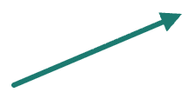






Static dependencies: what feeds what
DEPENDENCY GRAPH · STATIC
FOUNDATION
ARTIFACTS
DERIVED
RELEASE
CONSUMERS
Domain ontologies
Mappings and labels
Visier views
SKL release
LangSmith evals
Core vocabulary and ontology
Rules and constraints
Logic and calcs
Agent grounding
Persona models
Decision models
HRScale code maps
Arrows read “is required by”. A change to any node forces review of everything to its right. Used for impact analysis in step 2 of the change flow.
SKL at the Center · Architecture for trustworthy AI
12
Notes:
Static means build-time and design-time: which SKL artifacts depend on which. This graph is generated from the SKL itself, so impact analysis is a query, not a meeting.

Slide 13






Run-time dependencies: who calls whom
DEPENDENCY GRAPH · RUN TIME
Client apps: Copilot, Compass, HRScale screens, partner APIs
Steward review queue
Agent or advisory (North Star)
MTBH circuit breaker
Persona and access
Concept resolution
Rules and calcs
LLM gateway and router
Trace collector (LangSmith or equivalent)
SKL graph store (internal only)
Model providers (external)
Solid arrows are run-time calls. Dashed arrows are traces and reports. The SKL services reach the graph only over the internal path, and the gateway is the only route to external model providers.
SKL at the Center · Architecture for trustworthy AI
13
Notes:
At run time the agent depends on four services, and only the services touch the graph. Traces from the agent and the gateway carry the SKL release ID to the trace collector. The MTBH breaker can force a fallback to rules or a person, and drift or gaps go to the steward queue, which feeds the design-time flow.

Slide 14
Consumers extend inside the lines the SKL draws
DOMAIN BOUNDARIES
CORE · OWNED BY THE SKL
Consumers may
Enterprise-wide vocabulary, upper ontology, shared rules and calcs
Add local terms, labels and views inside their domain. Propose new concepts and rules.
DOMAIN · BENEFITS, PAYROLL, COMPLIANCE, ADVISORY
Domain vocabularies, taxonomies and ontologies, stewarded per domain
EXTENSION ZONE · CONSUMER TERMS
Consumers must
Alternate labels and local terms, each mapped to an SKL ID
Map every term to an SKL ID, carry the release ID, and stay inside domain boundaries.
Consumers must not
Redefine a core concept, fork a taxonomy, or keep rules and calcs outside the SKL.
SKL at the Center · Architecture for trustworthy AI
14
Notes:
Alternate labels live in their own layer so core and domain vocabularies stay clean. An extension is valid only if it maps to an SKL ID.

Slide 15
Where LangSmith and other tools fit
CONSUMERS
Tool | Role | May extend | Must adhere to
Visier | Analytics and metric semantics | Local metric views and labels | Consume SKL releases through the API layer; no authoring of shared terms
LangSmith | LLM tracing, evals, monitoring | Eval datasets, trace tags, scores | Tag traces with the SKL release; derive tests from SKL rules; hold no rules or vocabularies as source
HRScale (Workday) | System of record | Local fields and codes | Map every code to an SKL concept
Copilot and Compass | Assistants and agents | Prompts, tools, persona settings | Ground answers in SKL services; cite rule and concept IDs
Any tool that creates or maintains semantics follows the same contract: extend, map, tag, propose.
SKL at the Center · Architecture for trustworthy AI
15
Notes:
This is a proposal for how each tool is positioned. LangSmith is an observability and evaluation consumer, not a source of truth. Visier is consumption-only per the SKL publishing proposal.

Slide 16
Why LangSmith fails the SSOT test
WHY NOT LANGSMITH AS THE SSOT
Test | Why it fails
Semantic store | No ontology classes, relations, SHACL-style constraints or alternate-label separation. The Insperity and customer label split has no home there.
Determinism | Rules held in prompts are interpreted by an LLM, so the same input can give different answers. That undercuts “models only for language.”
Machine-readable foundations | Decision models need typed entities, explicit relations and versioned rule sets. Free text in a prompt is none of these.
Governance | Our design routes changes through provisioned UX with logging, auditing and Personas and Jobs access. LangSmith’s access model is built for engineers iterating on prompts.
Graph exposure | The graph is never exposed to third parties. A SaaS copy of the knowledge conflicts with that rule; only self-hosting softens it.
LangSmith earns its place as a consumer for tracing and evaluation, not as a source of truth.
SKL at the Center · Architecture for trustworthy AI
16
Notes:
Each row is a test the SSOT must pass. LangSmith can pass the observability and evaluation job, which is why it stays in the architecture as a consumer.

Slide 17
Would Insperity embed its IP in LangSmith?
PROTECTING THE IP
LOCK-IN
DATA EXPOSURE
A proprietary format on one vendor’s terms
IP and client context in a third-party system
The logic would follow one vendor’s roadmap and pricing, the exposure the “weather AI cost spikes” theme is meant to remove.
The knowledge and the employee and client context around it would sit outside Insperity.
EXPLAINABILITY
COMPETING SOURCES OF TRUTH
A prompt, not a rule
A second store beside Visier
An auditor could be shown a prompt, but not the rule behind a recommendation.
Visier already curates semantics in places. Another store would make that worse.
Almost certainly not. The Keel is Insperity’s IP, and its value is a portable, standards-based asset that outlasts any vendor or model.
SKL at the Center · Architecture for trustworthy AI
17
Notes:
This is the business case for keeping the SKL as the centerpiece: the knowledge asset stays portable, auditable and under Insperity’s control.

Slide 18
Alignment has a cost, and it is worth paying
SYNC, REPLICATION AND MAPPING
Concern | Mechanism | Overhead we accept
Identity | A stable SKL ID for every concept; consumers store the ID, not only the label | ID assignment and registry upkeep
Labels | Alternate labels (Insperity, customer) held in a separate layer, never in core | A second layer to maintain
Mapping | Mapping graph from consumer terms to SKL concepts, with a match type: exact, broader, narrower or related | Steward effort for each new consumer
Replication | Read-only copies published outward by release; no write-back | Release cadence and diff review
Drift | Scheduled reconciliation of each consumer against the current release | Reconciliation jobs and an exception queue
This is the price of resolving ambiguity once, centrally, instead of in every integration.
SKL at the Center · Architecture for trustworthy AI
18
Notes:
The overhead is real and should be staffed. It replaces the hidden cost of each team reconciling meanings on its own.

Slide 19
Every change is aligned before it ships
DESIGN-TIME ALIGNMENT
1 Change request
2 Impact analysis
3 Governance check
4 Test
5 Release
6 Consumers realign
Cases generated from rules, expected answers computed
Versioned, diffed, given a release ID
From a consumer or a steward
Concepts, rules, calcs, mappings and consumers affected
Naming standards, boundaries, steward approval
Publish, remap, refresh evals
Consumer or steward
SKL team
SKL steward
Automated
SKL steward
Consumer owners
Gate: no release, no publish. Nothing reaches a consumer without passing steps 2 to 5.
Rejected at step 3 or 4: the request returns to its owner with the failing rule or boundary named.
SKL at the Center · Architecture for trustworthy AI
19
Notes:
Design-time alignment is where terms, taxonomies and SSOT artifacts stay in step. Test cases come from the rules themselves, so expected answers are computed, not guessed.

Slide 20
What each SKL change triggers downstream
DESIGN-TIME ALIGNMENT
SKL change | Design-time check | Consumer alignment
New term or concept | Duplicate and boundary check; assign an ID | Publish to Visier; add the term to LangSmith eval vocabulary
Alternate label | Confirm the change stays in the label layer, core untouched | Refresh label sets for each affected consumer
Taxonomy move | Impact on rules and mappings that use the node | Re-map consumer terms; re-run affected evals
Rule, constraint or calc | Regression cases from the rule; compliance review; sign-off | Update agent grounding; refresh expected answers; notify owners
Persona or access | Access review through Personas and Jobs | Re-provision; re-test persona-scoped answers
Each row ends in the same place: a release that every consumer can reconcile against.
SKL at the Center · Architecture for trustworthy AI
20
Notes:
Use this table as the design-time checklist for the change board.

Slide 21

Serve, observe and measure against the SKL
RUN-TIME ALIGNMENT
SERVE
Request
Persona and access
Agent or advisory
SKL services
Response
Employee or SMB owner asks
North Star decides what to ask
Rules, calcs and concepts. Language model for wording only.
With rule and release IDs
Personas and Jobs sets scope
Every step emits a trace tagged with the SKL release, persona and rule IDs
OBSERVE AND MEASURE
Trace store
Measures
MTBH circuit breaker
Action
LangSmith or an equivalent tool
Resolution, grounding, calc fidelity, cost, drift
Trips when confidence drops
Fall back to rules or a person; send drift to a steward
SKL at the Center · Architecture for trustworthy AI
21
Notes:
Run-time alignment checks that what is served still matches the SKL release in force. Stewards fix root causes through the design-time flow, not in the monitoring tool.

Slide 22
Six measures keep the language layer honest
RUN-TIME ALIGNMENT
Measure | What it shows | Source | On breach
Concept resolution | Share of terms resolved to SKL IDs; unmapped term rate | Traces | Open a mapping proposal for stewards
Grounding and audit | Answers backed by governed content, with release, rule and persona IDs | Traces, evals | Route to rules or a person
Calc fidelity | Outputs match SKL logic on golden cases | Scheduled evals | Alert the owner; pin the prior release
Reliability (MTBH) | Time between hallucinations and the confidence trend | Evals, user flags | Trip the circuit breaker
Cost per answer | Tokens and model tier used for each answer | Traces | Re-route to a smaller model
Drift | Consumer vocabulary compared with the current release | Reconciliation | Add to the steward review queue
Thresholds are set per domain by stewards and recorded in the SKL, so the limits are governed too.
SKL at the Center · Architecture for trustworthy AI
22
Notes:
No target values are proposed here. Baseline first during the pilot, then set thresholds with the domain stewards.

Slide 23
Compliance is built into the SKL, not bolted on
TRUSTWORTHY AI AND COMPLIANCE
TRACEABILITY
EXPLAINABILITY
ACCESS CONTROL
Every output links to its source
Logic an auditor can read
Scoped by persona and job
Rule, concept and release IDs travel with each answer.
Deterministic rules and deontic norms, not prompt text.
Personas and Jobs gives fine-grained access beyond ACLs.
AUDITABILITY
HUMAN OVERSIGHT
ROBUSTNESS
Every change is logged
People decide what enters
Reliability is measured
Staff edit the graph only through provisioned, audited UX.
Stewards approve changes; the breaker hands off to a person.
MTBH tracks hallucinations and falls back to rules.
Mapping these controls to external frameworks, such as NIST AI RMF and ISO/IEC 42001, is to be confirmed with compliance.
SKL at the Center · Architecture for trustworthy AI
23
Notes:
End-to-end compliance works because the same IDs run from design-time approval through run-time traces.

Slide 24
Establish, connect, scale
ROADMAP AND DECISIONS
0–6 MONTHS
6–12 MONTHS
12–18 MONTHS
Establish
Connect
Scale
One pilot domain. Release process and steward roles. SKL as source of truth, publishing into Visier.
LangSmith traces tagged with release IDs. Evals derived from SKL rules. Mapping graph and drift reconciliation.
More domains, partner APIs, and a run-time trust view for compliance.
Decisions requested
1 Confirm the SKL as the only authoring point for shared semantics. 2 Name a steward for each domain. 3 Pick the pilot: downturn workforce advisory.
SKL at the Center · Architecture for trustworthy AI
24
Notes:
The pilot matches the next step proposed in Navigating Rough Seas.

